Slide 1
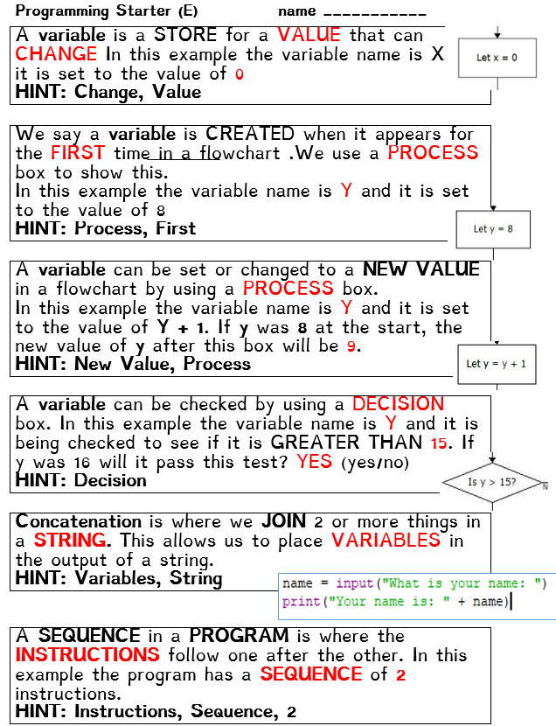
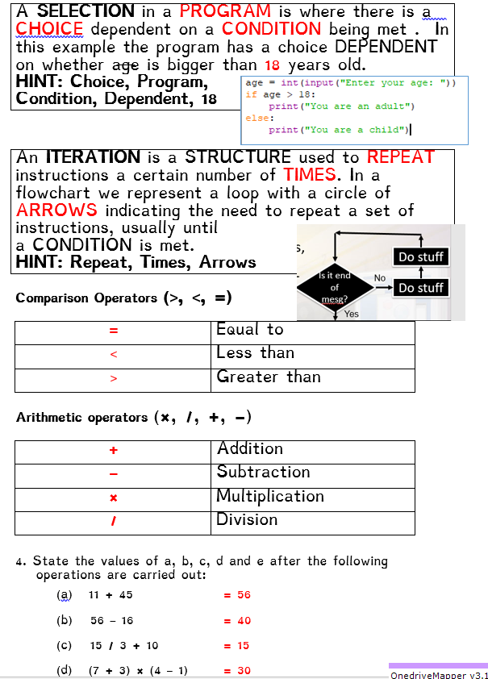

Slide 2
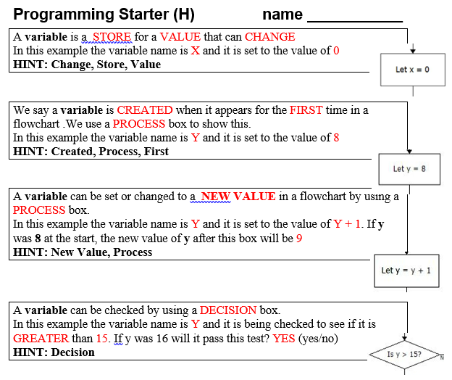
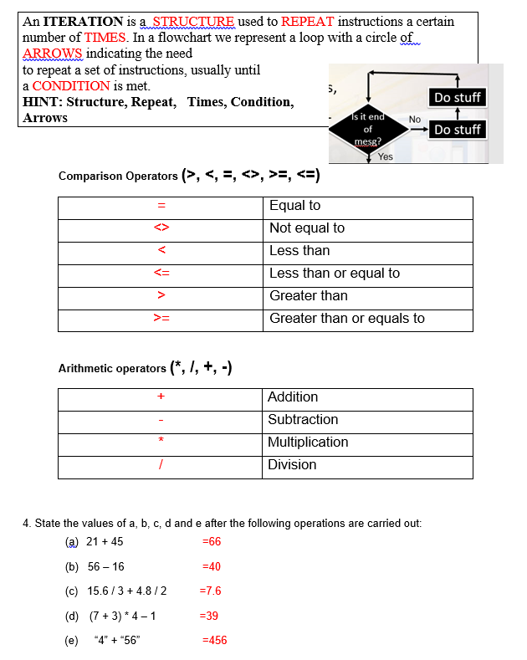
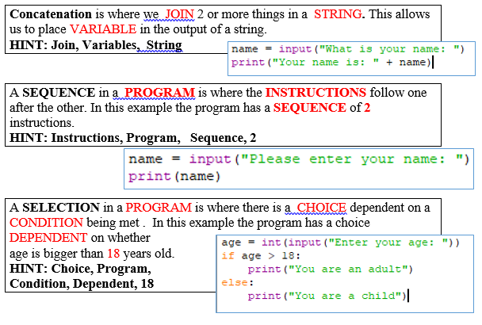

Slide 3
Level Descriptors: KS3 Programming
Level 3 Create a linear program incorporating basic user inputs and outputs Declare and assign information to variables Concatenate strings with information assigned to variables
Level 4 Identify the need to store information with different data types Use IF and ELSE statements to make decisions Use WHILE and FOR loops for iterative processes Use the: ‘equal to’, ‘not equal to’, ‘greater than’ and ‘less than’ comparison operators
Level 5 Use subroutines to create efficient programs and reduce duplication of code Use 1-dimentional arrays to store and retrieve information Use bitwise operators: ‘AND’ & ‘OR’ as part of conditions to be evaluated
Level 6 Use of functions which take arguments and return values to create efficient programs Use of 2-dimentional arrays to store and retrieve information https://www.youtube.com/watch?v=dU1xS07N-FA

Slide 4

Introduction to Small Basic
In this lesson, you will learn how to:
Identify a loop.
Understand how a FOR loop works.
Understand how a WHILE loop works
Use IntelliSense® technology.
Save your program.

Slide 5
What is a LOOP?
A LOOP is a __________ used to _______ instructions a certain number of ________
In a flowchart we represent a loop with a circle of _______ indicating the need to repeat a set of instructions,
usually until a ____________ is met.
Do stuff
Is it end of mesg?
No
Do stuff
Yes
Task 1: Fill in the gaps.
HINT: STRUCTURE , REPEAT, TIMES, CONDITION, ARROWS

Slide 6
What is a LOOP?
LITERACY CORNER
Other words meaning ‘to loop’ a set of instructions:
Repeat
Iteration
Task 1: Can you find any other words meaning ‘to loop’ or repeat something

Slide 7
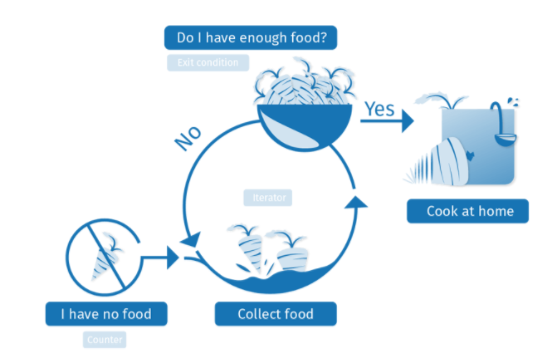
What is a loop?
.
Ans:
C
A
B
Task 1: Where is the loop, A, B or C
HINT: Look for something that will repeat

Slide 8
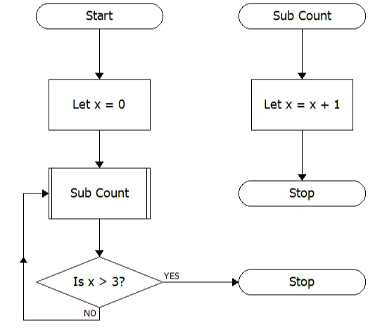
What is a loop?
Task 1: Where is the loop, A, B or C
HINT: Look for something that will repeat.
What is the condition that will stop the loop from continuing?
.
A
D
Ans:
B
C
Ans:

Slide 9
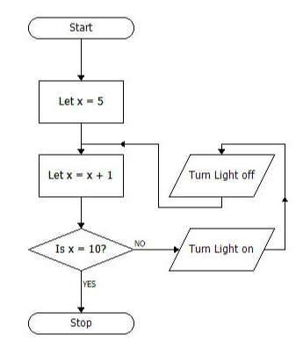
What is a loop?
Task 2: Where is the loop, A, B, C or D
HINT: Look for something that will repeat.
What is the condition that will stop the loop from continuing?
.
C
A
Ans:
A
B
B
C
Ans:
Task 1: Where is the loop, A, B or C
HINT: Look for something that will repeat
D

Slide 10
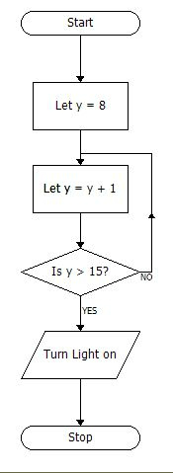
What is a loop?
Task 3: Where is the loop, A, B, C or D
HINT: Look for something that will repeat.
What is the condition that will stop the loop from continuing?
Ans:
A
Ans:
B
Ans:
C
D

Slide 11
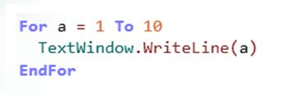
What is a FOR LOOP?
A FOR _______ is a __________ where the _______ are repeated a certain _______ of times. In this example the program will repeat the TextWindow.WriteLine(a) ____ times
Task 1: Fill in the gaps.
HINT: LOOP, INSTRUCTIONS, STRUCTURE, NUMBER

Slide 12
What does this command do?
TASK 1: Write the following in Small Basic
How many times will the instruction repeat?
Can you explain what this program does?

Slide 13
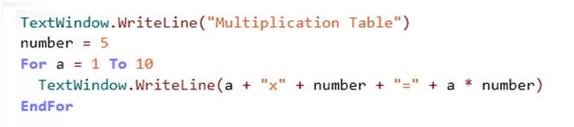
What does this command do?
TASK 2: Write the following in Small Basic
How many times will the instruction repeat?
Can you explain what this program does?

Slide 14
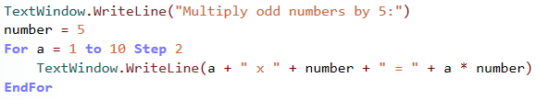
What does this command do?
TASK 3: Write the following in Small Basic
How many times will the instruction repeat?
Can you explain what the STEP command does?

Slide 15
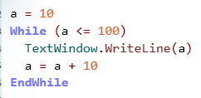
What is a WHILE LOOP?
A WHILE _______ is a __________ where the _______ are repeated until a ________ is met. In this example the program will repeat the TextWindow.WriteLine(a) ____ times
Task 1: Fill in the gaps.
HINT: LOOP, INSTRUCTIONS, STRUCTURE, NUMBER

Slide 16
What does this command do?
TASK 4: Write the following in Small Basic
How many times did the instruction repeat?
What is the condition that will STOP the loop?

Slide 17
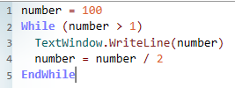
What does this command do?
TASK 5: Write the following in Small Basic
How many times did the instruction repeat?
What is the condition that will STOP the loop?

Slide 18
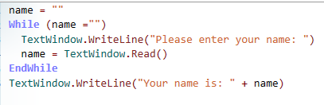
What does this command do?
TASK 6: Write the following in Small Basic
How many times did the instruction repeat?
What is the condition that will STOP the loop?
What is the program trying to make sure happens?

Slide 19
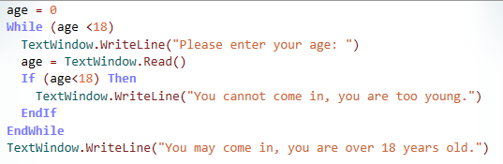
What does this command do?
TASK 7: Write the following in Small Basic
How many times did the instruction repeat?
What is the condition that will STOP the loop?
What is the program trying to make sure happens?

Slide 20
What does this command do?
Extension
Computers and things controlled by computers are very good at repeating things perfectly. Can you create a presentation on something that repeats and is computer controlled. Possible topics include:
Robots , Roller coasters, Traffic control systems,
Train management systems, Heating systems
For each explain:
What they do
Who invented them
How they use repetition/iteration and

